Slide 1
BUSINESS INSIGHTS 360
Power BI Dashboard | Power Query | Data Analysis | DAX | Data Modeling
By: Akash Kumar

Slide 2
About the Project
Link to live project -
The project has been built using Microsoft Power BI.
It consists of a multi-functional dashboard with 5 different views - Finance, Sales, Marketing, Supply Chain and Executive.
Each view has been customized with different visuals and graphs.
Every view is supported by filters and connected to other views by navigation - to navigate click on the icons
Refer to footer notes for abbreviations.
Date filters( vs LY/Target, YTD/YTG), product and region filters can be applied at multiple levels.

Slide 3
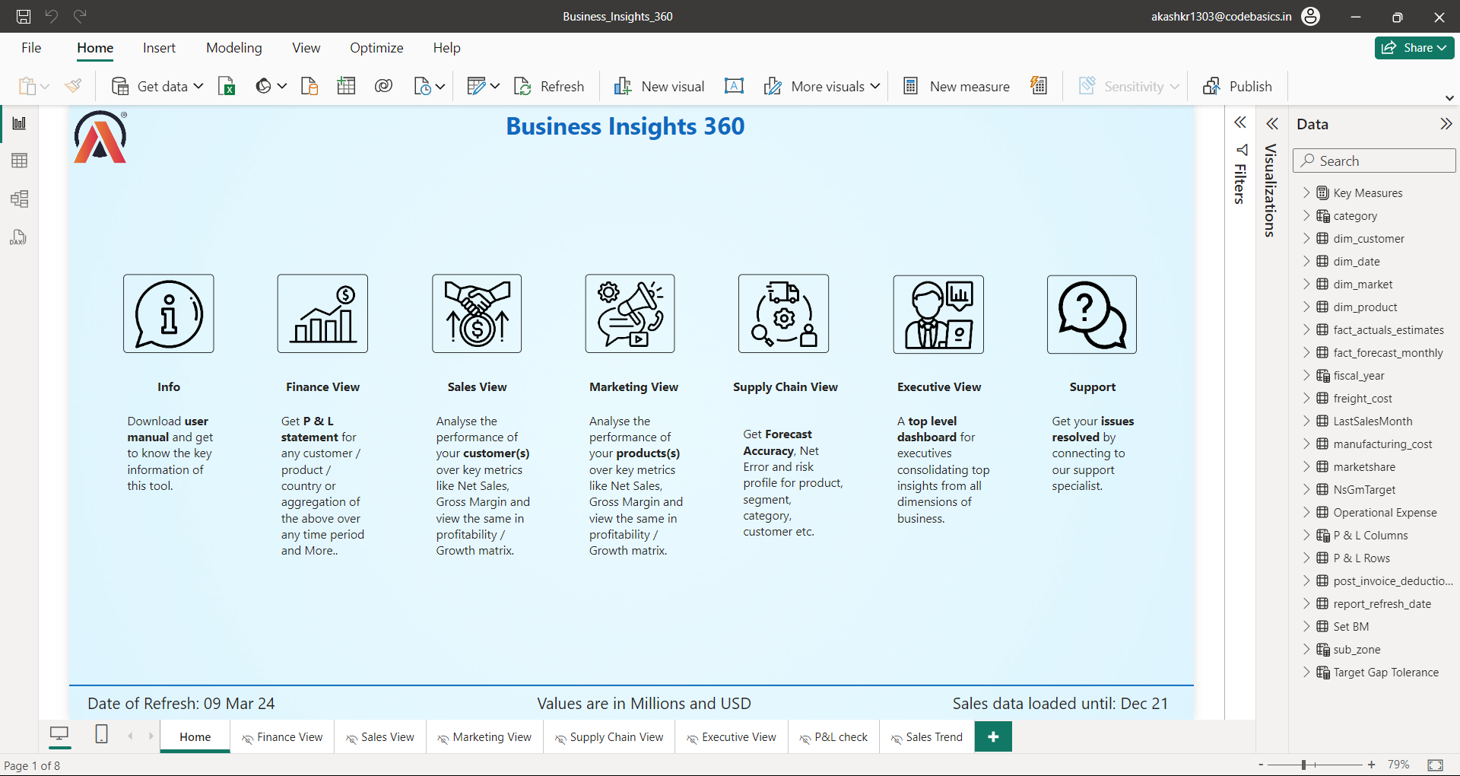

Slide 4
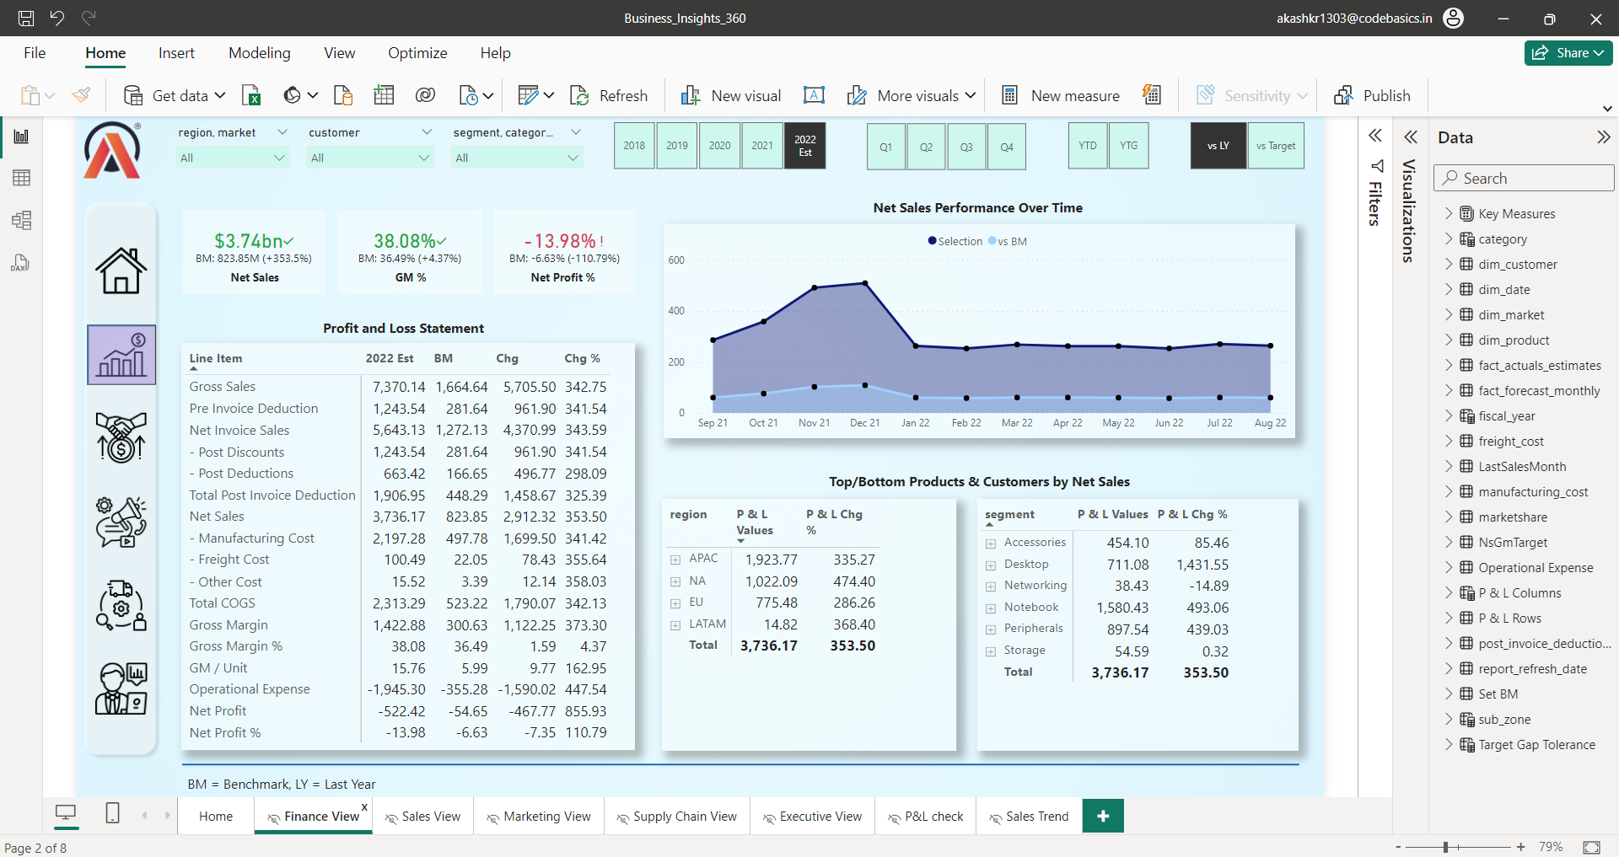

Slide 5
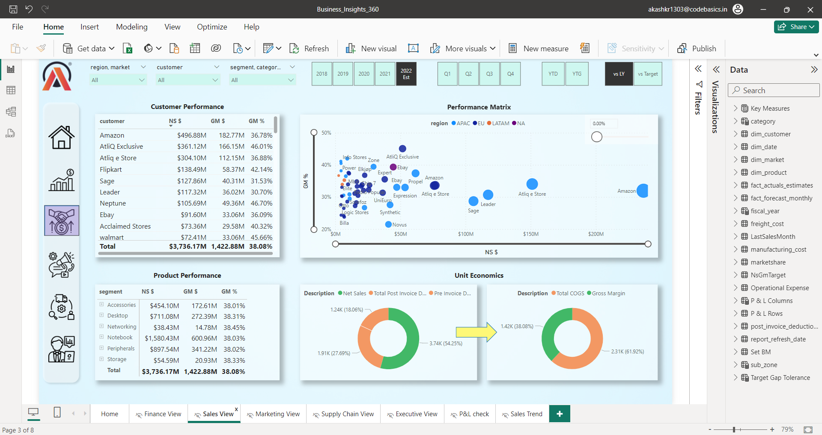

Slide 6
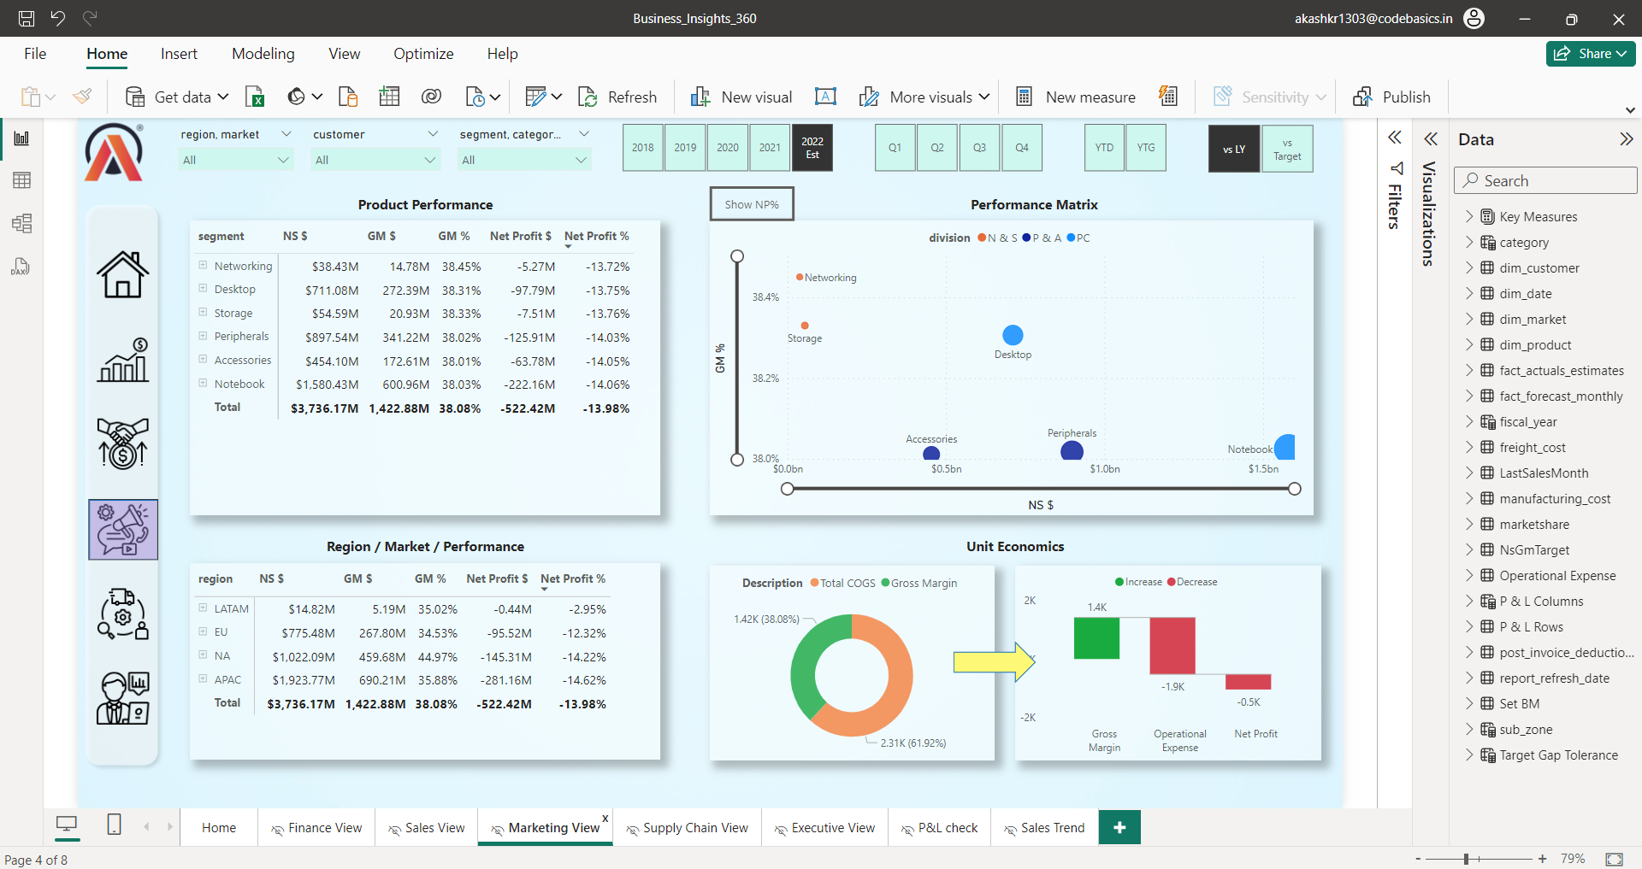

Slide 7
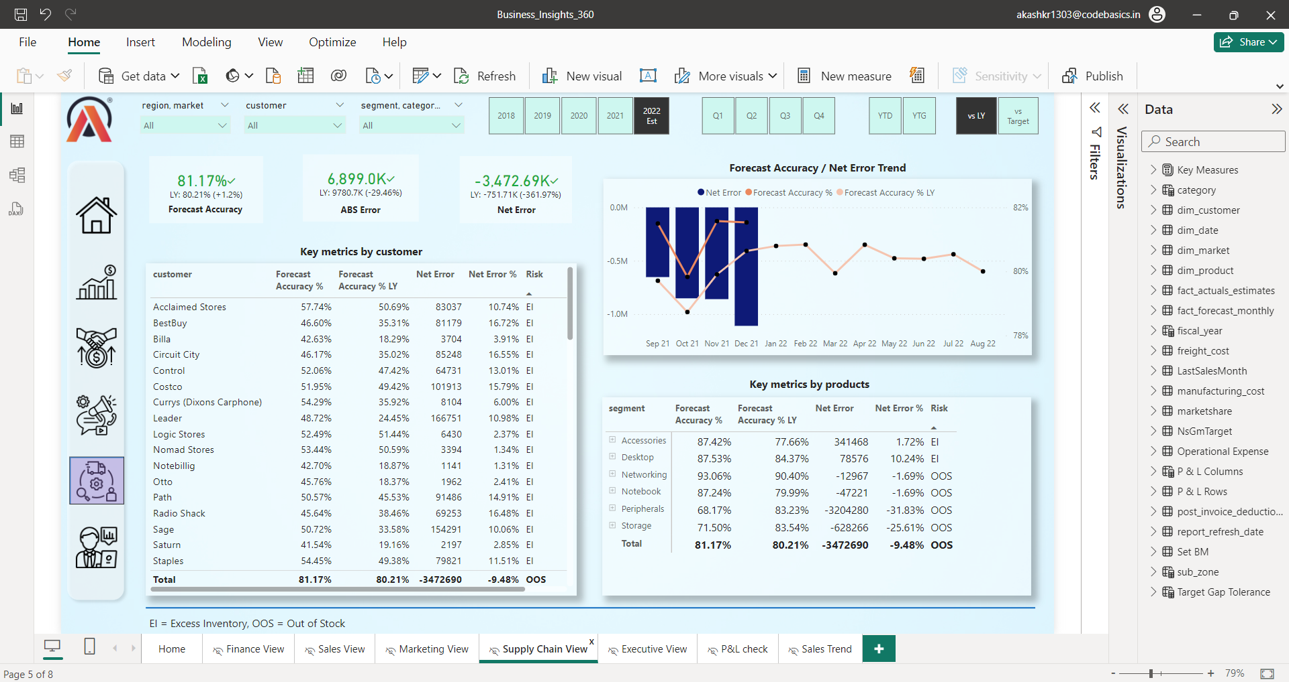

Slide 8
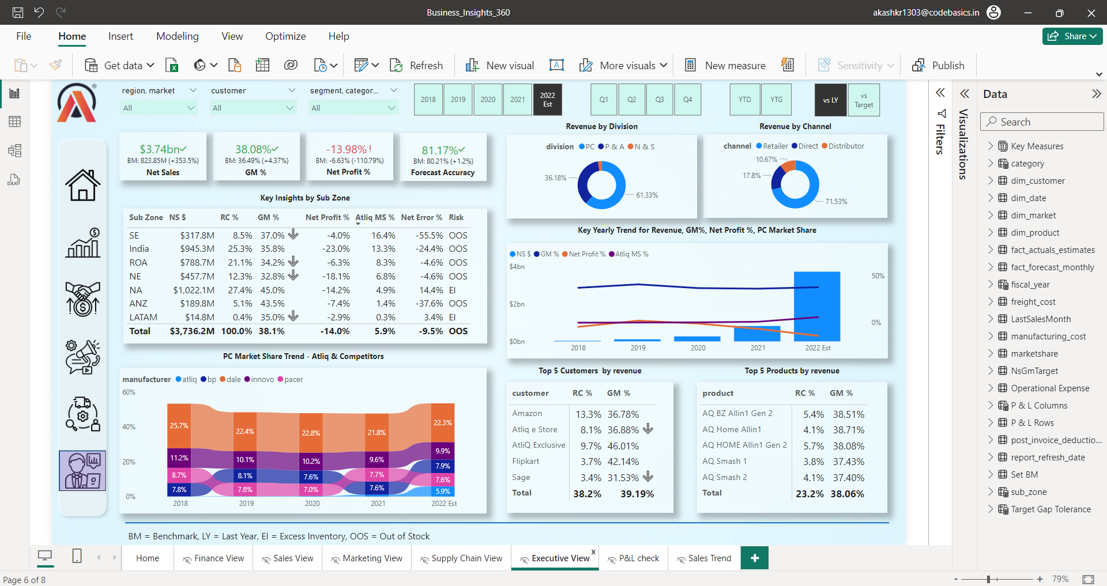

Slide 9
Go ahead, explore vital insights from the dashboard
THANK YOU :)

